Slide 1
Buying a House
Mortgages

Slide 2
How do mortgages work?
They’re a long term secured loan where the lender has the right to take your property if you fail to repay.
Mortgages largely depend on the length of mortgage, loan-to-value ratio, initial term, your ability to repay.
There are a few different types of mortgage and lots of variations within each of these types.
See the next slide for more info…

Slide 3
Types of Mortgage
Repayment or interest only
Fixed rate or variable (tracker, standard variable rate, discounted)
Moneysavingexpert’s…
What Type of Mortgage to Choose,
Mortgage Best Buys,
Mortgage Calculators

Slide 4
How do you plan the finances to buy a house?
Multiply your income by 4.5 (or joint income by 3.5) to get the max value that you’re likely to be able to borrow.
Divide this total by 9 (cos you'll borrow 90%) to find the size of your 10% deposit, or by 19 for a 5% deposit.
Multiply this deposit-figure by 10, for 10% deposit, or 20, for 5% deposit, to get your maximum affordable house price.
Now save up your deposit + ~£10,000 for your moving costs

Slide 5
How do you plan the finances to buy a house?
Mortgage multiple = 4.5 or 3.5 joint
Divide by 9 or 19 to find required min deposit, then + £10k
Multiply by 10 or 20 to find max purchase value
Calculate what the following people can afford…
A single person earning £35,000 pa
A couple earning £25,000 each pa
A single person earning £50,000 pa

Slide 6
Find that Dream Home
Each of our people live in different parts of the UK. What might their first homes be like?
Whichever it is, they’ll probably start on rightmove.co.uk
Calculate what the following people can afford…
Single person A wants to be able to commute to Norwich
Our couple B, want to live near the coast
Single person C wants to live in London

Slide 7
How do you negotiate buying the house?
So you’ve found your dream first home on rightmove.co.uk
Contact the estate agent to arrange a viewing
Speak to a mortgage broker to get an agreement in principle
Go for a second viewing
Negotiate the price, if possible. First-time-buyers and cash buyers are preferable so use this to your advantage.
Put in an offer. Wait. Breathe.

Slide 8
What’s that £10k moving costs all about?!
Stamp duty - currently 0% on ≤£250k then 5% on ≤£925k
Estate agents - the seller pays these, ~1% of house value
The moving company - ~£1000+
Solicitors fees - buying and selling, ~£700 each
Surveys - a few hundred
Life insurance - paid monthly ~£20pm
Critical illness cover - paid monthly ~£20pm
House insurance - building and contents ~£150pa

Slide 9
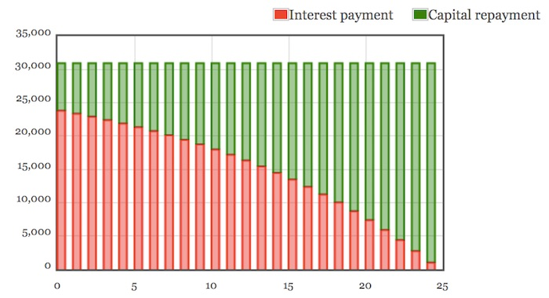
Pay as much as you can, as soon as you can
At the start of a mortgage, interest payments are high and capital repayments are low
As the mortgage develops, the interest payments decrease and capital payments increase
Overpayments can make a big difference
Mr Colman’s calculator here

Slide 10
Tips and Tricks to Save £1000s
Plan for 2-5 years at a time. After which, the value of your house will have increased and amount borrowed decreased. Your LTV rate will be much lower and you'll get much better borrowing rates.
Overpay the mortgage if your mortgage rate is higher than savings rates. Otherwise, put overpayments into savings accounts to bank the interest.
Get a 25% boost on your deposit with a LISA
Help to Buy - you'll need it but wish you didn't. The devil is in the details.

Slide 11
Stamp Duty Land Tax over the years
These figures on the amount in that bracket
These figures on whole amount
Purchase Price | 3/12 - 12/14 | 12/14 - 7/20 | 7/20 - 6/21 | 7/21 - 9/21 | 10/21 - 9/22 | 9/22 - current
Up to £125,000 | 0% | 0% | 0% | 0% | 0% | 0%
Over £125,000 to £250,000 | 1% | 2% | 0% | 0% | 2% | 0%
Over £250,000 to £500,000 | 3% | 5% | 0% | 5% | 5% | 5%
Over £500,000 to £925,000 | 4% | 5% | 5% | 5% | 5% | 5%
Over £925,000 to £1.5 million | 5% | 10% | 10% | 10% | 10% | 10%
Over £1.5 million to £2 million | 5% | 12% | 12% | 12% | 12% | 12%
Above £2 million | 7% | 12% | 12% | 12% | 12% | 12%

Slide 12
Stamp Duty Land Tax over the years
These figures on the amount in that bracket
These figures on whole amount
Purchase Price | 3/12 - 12/14 | 12/14 - 7/20 | 7/20 - 6/21 | 7/21 - 9/21 | 10/21 - 9/22 | 9/22 - current
Up to £125,000 | 0% | 0% | 0% | 0% | 0% | 0%
Over £125,000 to £250,000 | 1% | 2% | 0% | 0% | 2% | 0%
Over £250,000 to £500,000 | 3% | 5% | 0% | 5% | 5% | 5%
Over £500,000 to £925,000 | 4% | 5% | 5% | 5% | 5% | 5%
Over £925,000 to £1.5 million | 5% | 10% | 10% | 10% | 10% | 10%
Over £1.5 million to £2 million | 5% | 12% | 12% | 12% | 12% | 12%
Above £2 million | 7% | 12% | 12% | 12% | 12% | 12%
Calculate the stamp duty due for a house valued at…
£180,000 in 2014
£240,000 in June 2020
£295,000 in June 2022
(Why these values in these years?)

Slide 13
Stamp Duty Land Tax over the years
The rest on the amount in that bracket
These figures on whole amount
Purchase Price | 3/12 - 12/14 | 12/14 - 7/20 | 7/20 - 6/21 | 7/21 - 9/21 | 10/21 - 9/22 | 9/22 - current
Up to £125,000 | 0% | 0% | 0% | 0% | 0% | 0%
Over £125,000 to £250,000 | 1% | 2% | 0% | 0% | 2% | 0%
Over £250,000 to £500,000 | 3% | 5% | 0% | 5% | 5% | 5%
Over £500,000 to £925,000 | 4% | 5% | 5% | 5% | 5% | 5%
Over £925,000 to £1.5 million | 5% | 10% | 10% | 10% | 10% | 10%
Over £1.5 million to £2 million | 5% | 12% | 12% | 12% | 12% | 12%
Above £2 million | 7% | 12% | 12% | 12% | 12% | 12%
Calculate the stamp duty due for a house valued at…
£180,000 in 2014 £1800
£240,000 in June 2020 £2500
£295,000 in June 2022 £4750
Average UK house prices

Slide 14
This Week's Top Tips
https://www.moneysavingexpert.com/latesttip/
31st Oct 2023…
Financial Education PDF textbook download
MSE’s Academy of Money
Money for your gran?
5.2% Easy access savings
https://www.moneysavingexpert.com/deals/

